Slide 1
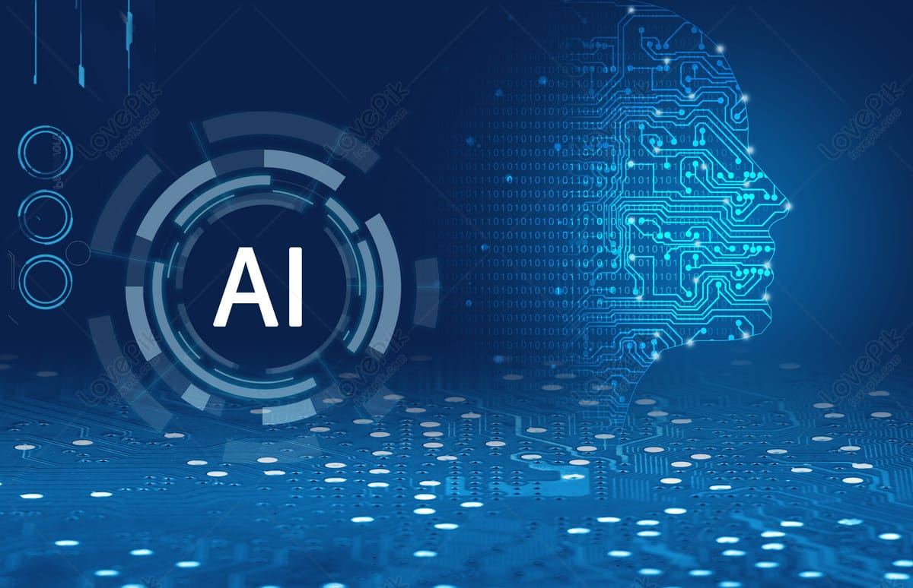

Slide 2
ADVANTAGES OF AI

Slide 3
1.REDUCTION IN HUMAN ERROR
One of the biggest benefits of AI is that it can significantly
Reduce errors and increase accuracy and precision .
The decisions taken by AI in every step is decided by
Information previously gathered and a certain set of
Algorithms. When programmed properly ,these errors can
be reduced to null.

Slide 4
2.ZERO RISKS
Another big benefit of AI is that humans can overcome
many risks by letting AI robots do them for us. Whether it
be defusing a bomb, going to space, exploring the deepest
Parts of oceans ,machines with metal bodies are resistant
in nature and can survive unfriendly atmospheres.
Moreover, they can provide accurate work with greater
responsibility and not wear out easily.

Slide 5

3.DAILY APPLICATIONS
Today, our everyday lives are entirely dependent on mobile
Devices and the internet. We utilize a number of apps,
Including Google maps, Alexa, OK Google etc. With the use
Of various AI based techniques, we can alsom anticipate
Today’s weather and the days ahead.

Slide 6
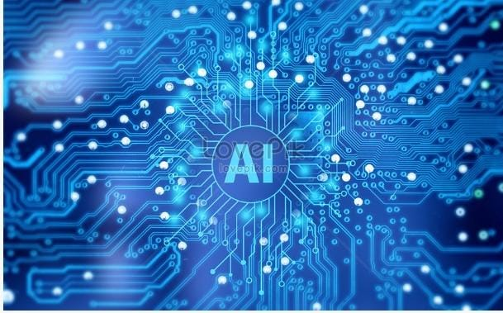
4.MEDICAL APPLICATIONS
AI has also made significant contributions to the
Field of medicine, with applications ranging from
Diagnosis and treatment to drug discovery and
Clinical trials.AI powered tools can help doctors
And researchers analyze patient data, identify
Potential health risks, and develop personalized
Treatment plans. This can lead to better health
Outcomes for patients and help accelerate the
Development of new medical treatments and technologies.

